Slide 1


INTELLIGENT FOOD WASTE TRACKER USING AI FOR SMART KITCHENS

Slide 2
Content
Abstract
Problem Statement
Objective
Data Collection and Preparation
Proposed Solution (Methodology)
Model Performance Evaluation
Screenshots / Demonstration (video)
Future Scope
Conclusion
Notes:
Abstract
Problem Statement (Clearly define the challenge)
Objective (State your project's goal)
Background and Research (Discuss existing solutions, trends, and gaps)
Data Collection and Preparation (Focus on data sources, cleaning, and augmentation)
Proposed Solution (Methodology)
Model Architecture (e.g., CNN, U-Net, YOLOv5)
Key Techniques (e.g., Transfer Learning, Image Augmentation)
Model Performance Evaluation
Metrics (Accuracy, Precision, Recall, IoU, etc.)
Graphs (Confusion Matrix, ROC Curve, etc.)
Screenshots / Demonstration (Visual proof of system functionality)
Future Scope (Improvements, scalability, and integration ideas)
Conclusion (Summarize results and impact)
Q&A Session

Slide 3
Abstract
Food waste is a significant challenge in the restaurant industry, leading to financial losses and environmental concerns. This study presents an AI-powered food waste tracking system designed to help restaurants monitor, analyze, and reduce waste efficiently. The system leverages machine learning algorithms to identify patterns in food disposal, predict demand fluctuations, and suggest portion adjustments based on historical data. By integrating computer vision, IoT sensors, and predictive analytics, the tracker provides real-time insights into waste sources, enabling staff to take corrective actions. Additionally, the AI model can recommend ingredient substitutions and inventory optimizations to minimize excess food. Through automated data collection and analysis, restaurants can enhance sustainability efforts, cut costs, and contribute to global food waste reduction initiatives.

Slide 4
Problem Statement
Restaurants face a growing challenge of food waste, leading to increased operational costs, environmental impact, and inefficiencies in inventory management. Traditional methods of tracking food waste rely on manual logging, which is time-consuming, prone to errors, and lacks predictive capabilities. Additionally, fluctuations in customer demand and inconsistent portion sizes contribute to excess food disposal. To address this issue, an AI-driven food waste tracker can leverage machine learning, computer vision, and real-time analytics to monitor waste patterns, predict demand, and optimize ingredient usage. By providing actionable insights, automated waste recognition, and AI-driven forecasting, this solution can help restaurants minimize food waste, reduce costs, and enhance sustainability efforts while improving overall efficiency.

Slide 5
Objective
The primary objective of an AI-driven food waste tracker is to minimize food waste in restaurants by leveraging advanced data analytics, machine learning, and automation. The system aims to accurately monitor and analyze food disposal patterns, predict demand variations, and optimize inventory management to reduce excess waste. By integrating AI-powered forecasting and real-time tracking, restaurants can make informed decisions on portion control, ingredient usage, and menu planning. The solution also seeks to enhance sustainability efforts by providing actionable insights that contribute to cost savings and environmental impact reduction, ultimately promoting efficient and responsible food management in the hospitality industry.

Slide 6
Data Collection and Preparation
The AI-powered food waste tracker gathers data from IoT sensors, smart bins, POS systems, inventory records, kitchen feedback, and customer behavior to monitor waste patterns. It also incorporates supply chain data to analyze procurement trends, uses weather and seasonal trends for demand forecasting, and leverages staff insights to refine AI models.
The collected data undergoes cleaning, standardization, and labeling to ensure accuracy. Integration from multiple sources allows for holistic waste analysis, while normalization helps in aligning measurements for precise predictions. AI models train on historical data to forecast demand, enabling real-time monitoring and automated reporting for better ingredient usage and menu planning. Additionally, automated action triggers help restaurants immediately address excess food disposal, enhancing sustainability efforts and reducing costs.

Slide 7
Proposed Solution (Methodology)
To minimize food waste and enhance operational efficiency, an AI-powered food waste tracking system will be implemented. This solution integrates IoT-enabled smart bins, computer vision, and machine learning algorithms to automatically monitor, classify, and analyze food waste in real time.
The system will:
Automate Waste Tracking: Smart bins with weight sensors and AI-powered cameras will detect and categorize discarded food items.
Predict Demand: Machine learning models will analyze historical sales, seasonal trends, and external factors to forecast customer demand and adjust inventory.
Optimize Portion Control: AI-driven insights will help restaurants adjust portion sizes based on consumption patterns, reducing plate waste.
Improve Inventory Management: The system will provide alerts on expiring ingredients and suggest optimal procurement strategies to prevent over-purchasing.

Slide 8
Model Performance Evaluation
Performance Metrics: Evaluates accuracy, precision, recall, and error rates for waste prediction.
Optimization Techniques: Uses hyperparameter tuning, regularization, and data augmentation
to refine AI models.
Real-Time Monitoring: Continuously retrains models, balances cloud and edge AI processing,
and automates alerts for waste reduction.
Automated Decision-Making: AI-driven insights adjust portion sizes, optimize inventory, and
refine procurement strategies.
User Feedback Integration: Staff inputs and customer trends help improve AI predictions and
fine-tune model recommendations.

Slide 9
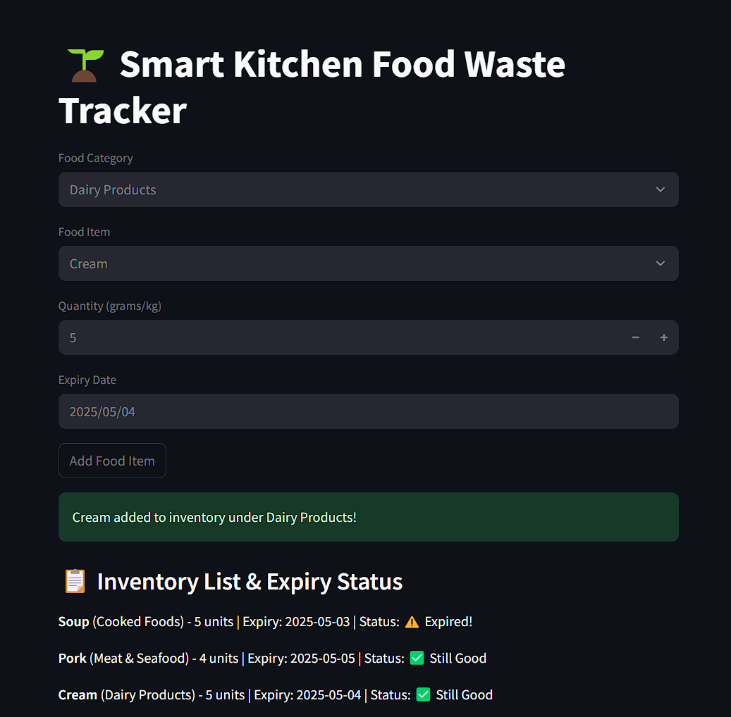

Screenshots / Demonstration (video)

Slide 10
Future Scope
Advanced AI Predictions: Improved forecasting for demand and inventory.
Automated Waste Reduction: Robotics and IoT for optimized food management.
Sustainable Practices: AI-driven donation, composting, and food upcycling.
Blockchain Integration: Transparent supply chain tracking for waste minimization.
Personalized Insights: AI-driven menu recommendations based on consumption patterns.
Industry Collaboration: Global AI networks for shared sustainability strategies.

Slide 11
Conclusion
The AI-powered food waste tracker offers a transformative solution for restaurants, enabling efficient monitoring, predictive analytics, and waste reduction strategies. By leveraging IoT sensors, machine learning, and data-driven insights, restaurants can minimize food waste, cut operational costs, and promote sustainability.
This system enhances inventory management, portion control, and real-time tracking, helping businesses make informed decisions while reducing environmental impact. As AI technology advances, future enhancements in automation, blockchain transparency, and global collaboration will further revolutionize waste management in the food industry.

